Slide 1
Evolution of ConvNets (~ResNet)
AlexNet, VGGNet, GoogLeNet, ResNet
모바일시스템공학과
박찬호
Krizhevsky, Alex, Ilya Sutskever, and Geoffrey E. Hinton. "Imagenet classification with deep convolutional neural networks." Advances in neural information processing systems. 2012. Simonyan, Karen, and Andrew Zisserman. "Very deep convolutional networks for large-scale image recognition." arXiv preprint arXiv:1409.1556 (2014). Szegedy, Christian, et al. "Going deeper with convolutions." Proceedings of the IEEE Conference on Computer Vision and Pattern Recognition. 2015. He, Kaiming, et al. "Deep residual learning for image recognition." arXiv preprint arXiv:1512.03385 (2015).

Slide 2
Contents
Before Getting Stared
Sequence Alignment
Encoder – Decoder (seq2seq)
Transformer structure
Positional Encoding
Self attention
Multi-head attention
Result

Slide 3
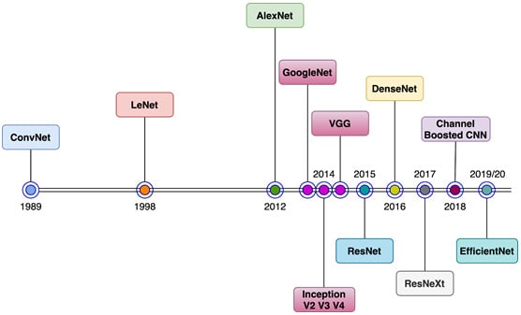
Before Getting Started
History timeline of ConvNet(CNN) models
ImageNet dataset – from WordNet
5247 synsets and 3.2 million images in total
ImageNet Large Scale Visual Recognition Challenge (ILSVRC)
https://analyticsindiamag.com/a-complete-guide-to-using-wordnet-in-nlp-applications/

Slide 4
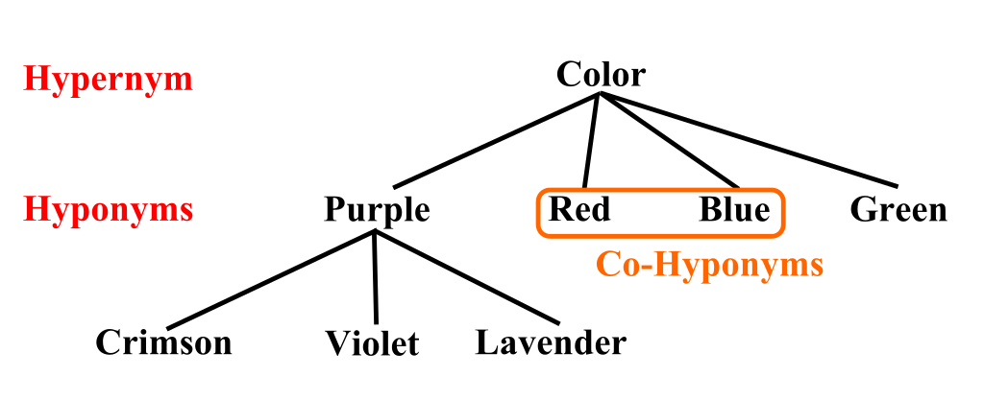
Before Getting Started
History timeline of ConvNet(CNN) models
ImageNet dataset – from WordNet
5247 synsets and 3.2 million images in total
ImageNet Large Scale Visual Recognition Challenge (ILSVRC)
https://analyticsindiamag.com/a-complete-guide-to-using-wordnet-in-nlp-applications/

Slide 5
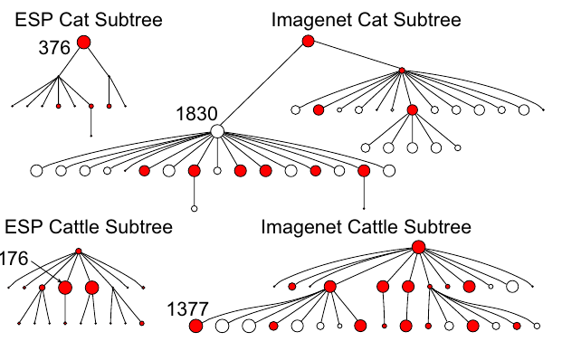
Before Getting Started
History timeline of ConvNet(CNN) models
ImageNet dataset – from WordNet
5247 synsets and 3.2 million images in total
ImageNet Large Scale Visual Recognition Challenge (ILSVRC)
J. Deng, W. Dong, R. Socher, L.-J. Li, K. Li and L. Fei-Fei, ImageNet: A Large-Scale Hierarchical Image Database. IEEE Computer Vision and Pattern Recognition (CVPR), 2009.

Slide 6
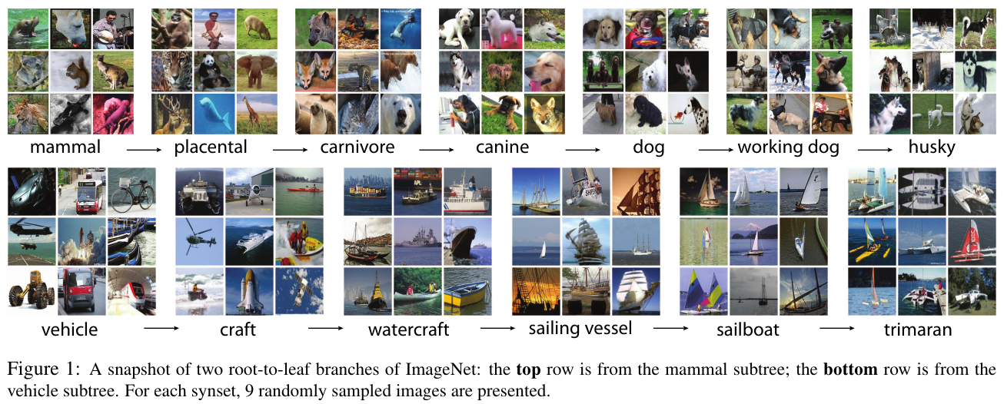
Before Getting Started
History timeline of ConvNet(CNN) models
ImageNet dataset – from WordNet
5247 synsets and 3.2 million images in total
ImageNet Large Scale Visual Recognition Challenge (ILSVRC)
J. Deng, W. Dong, R. Socher, L.-J. Li, K. Li and L. Fei-Fei, ImageNet: A Large-Scale Hierarchical Image Database. IEEE Computer Vision and Pattern Recognition (CVPR), 2009.

Slide 7
Before Getting Started
History timeline of ConvNet(CNN) models
ImageNet dataset – from WordNet
5247 synsets and 3.2 million images in total
ImageNet Large Scale Visual Recognition Challenge (ILSVRC)
J. Deng, W. Dong, R. Socher, L.-J. Li, K. Li and L. Fei-Fei, ImageNet: A Large-Scale Hierarchical Image Database. IEEE Computer Vision and Pattern Recognition (CVPR), 2009.

Slide 8
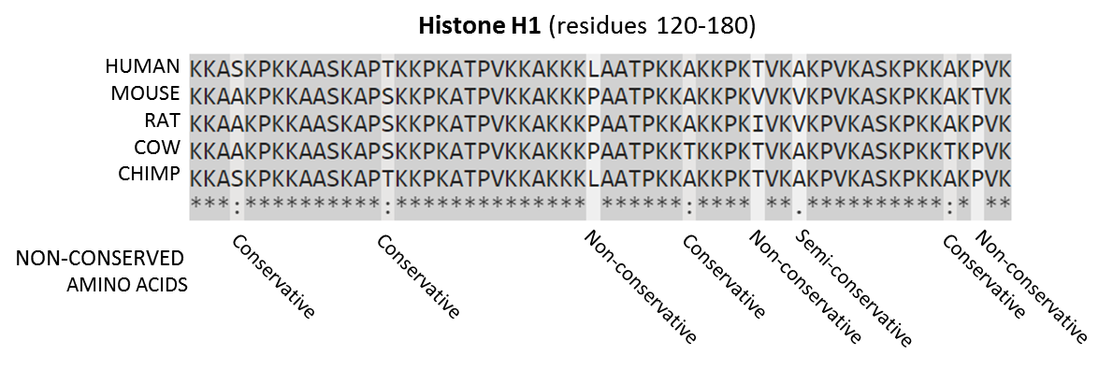
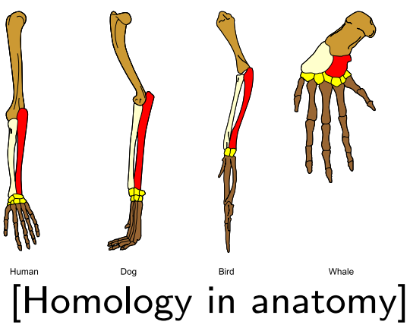
AlexNet
Computational Biology or Bioinformatics
Sequence Alignment
Subsequence among DNAs, RNAs, proteins
Sequence Homology
Share common ancestor
Point mutation, gaps, indels
→ Use edit distance
https://en.wikipedia.org/wiki/Sequence_alignment https://math.mit.edu/classes/18.417/Slides/alignment.pdf

Slide 9
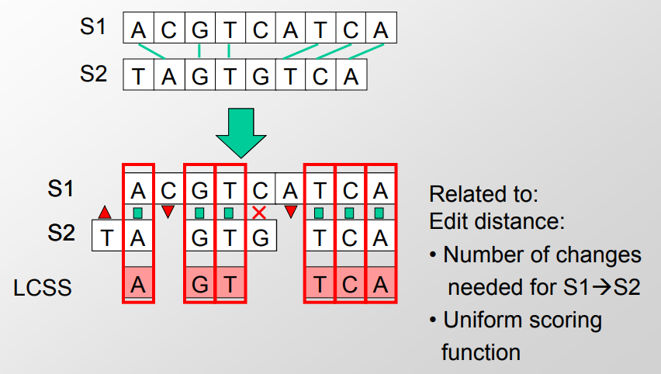
Sequence Alignment
Edit distance allowed
Comparing to sequences → find longest common subsequence
https://ocw.mit.edu/courses/6-047-computational-biology-fall-2015/2eddab6441d8092607e1259aafceb280_MIT6_047F15_Lecture02.pdf

Slide 10
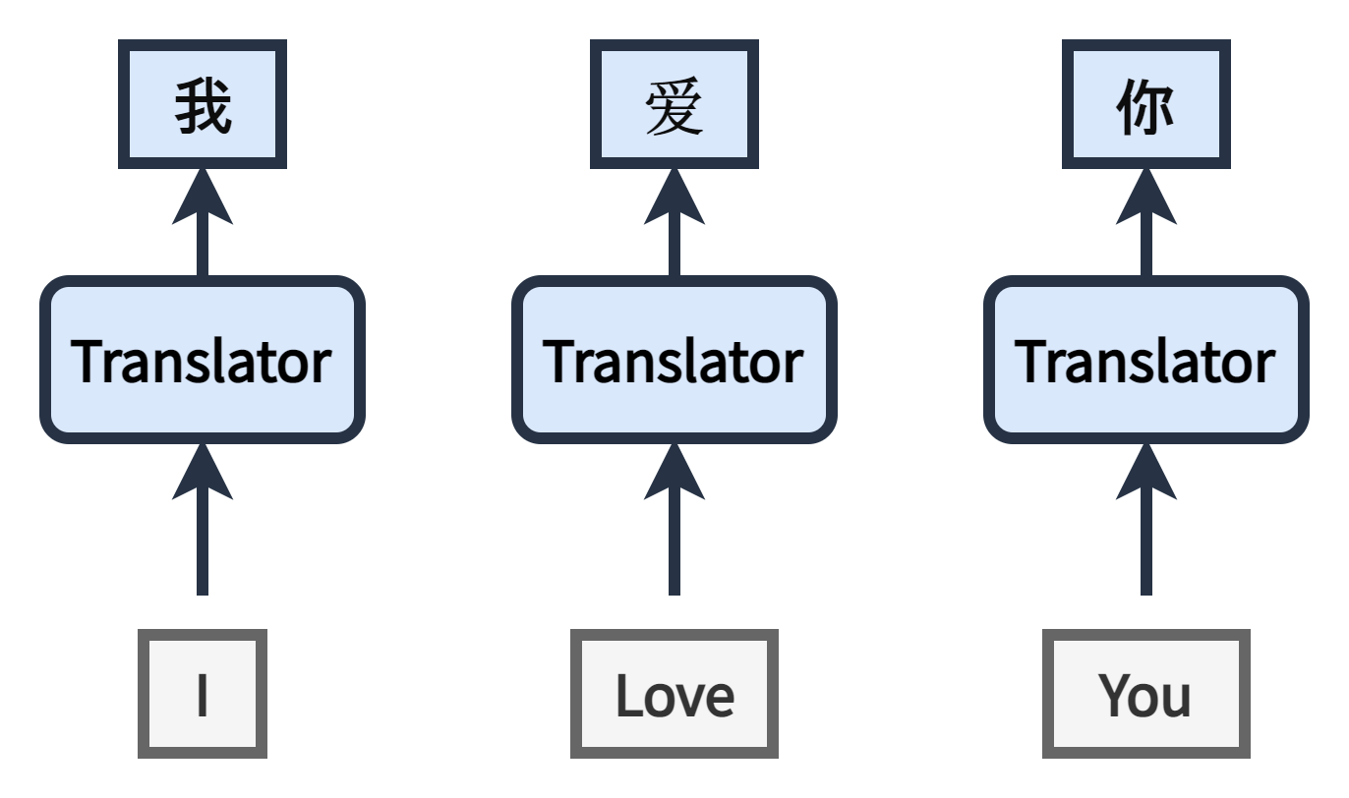
Alignment in NLP
Alignment between input sequence and output sequence
Ex) I Love You → Chinese and French
Single module translation model → One to one matching
https://dos-tacos.github.io/concept/alignment-in-rnn/

Slide 11
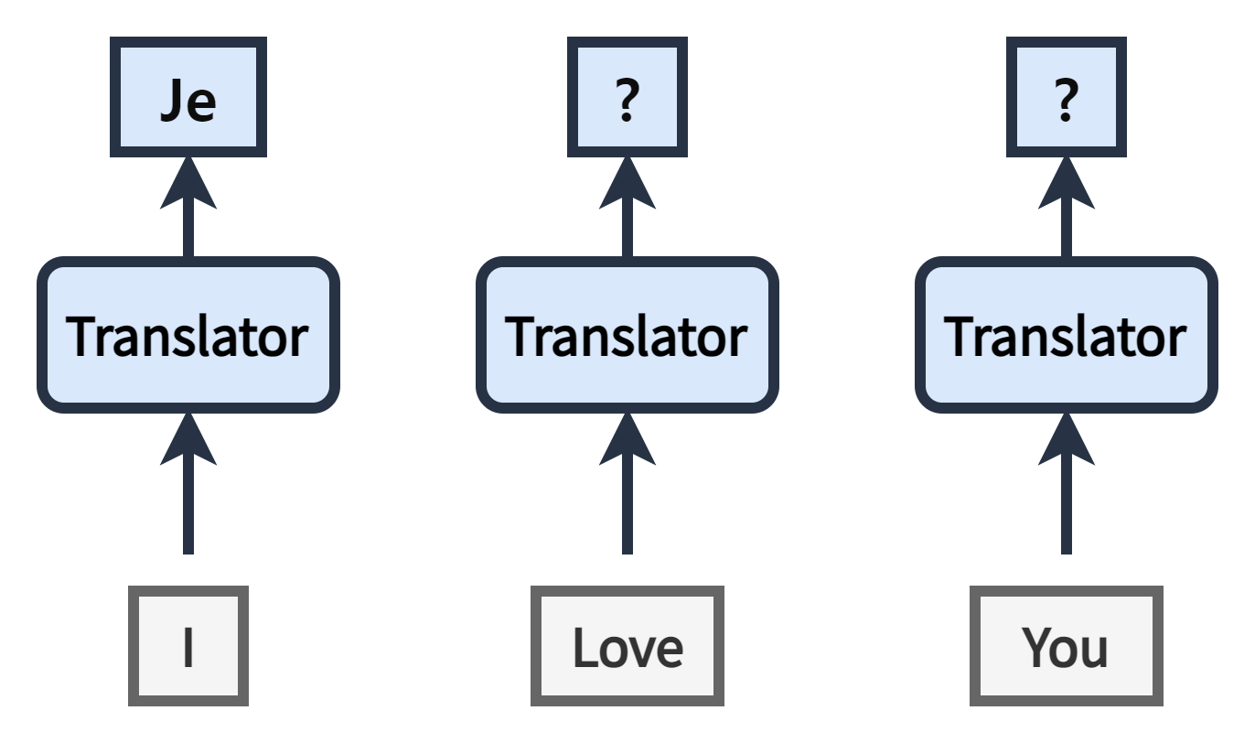
Alignment in NLP
Alignment between input sequence and output sequence
Ex) I Love You → Chinese and French
Single module translation model → One to one matching
https://dos-tacos.github.io/concept/alignment-in-rnn/

Slide 12
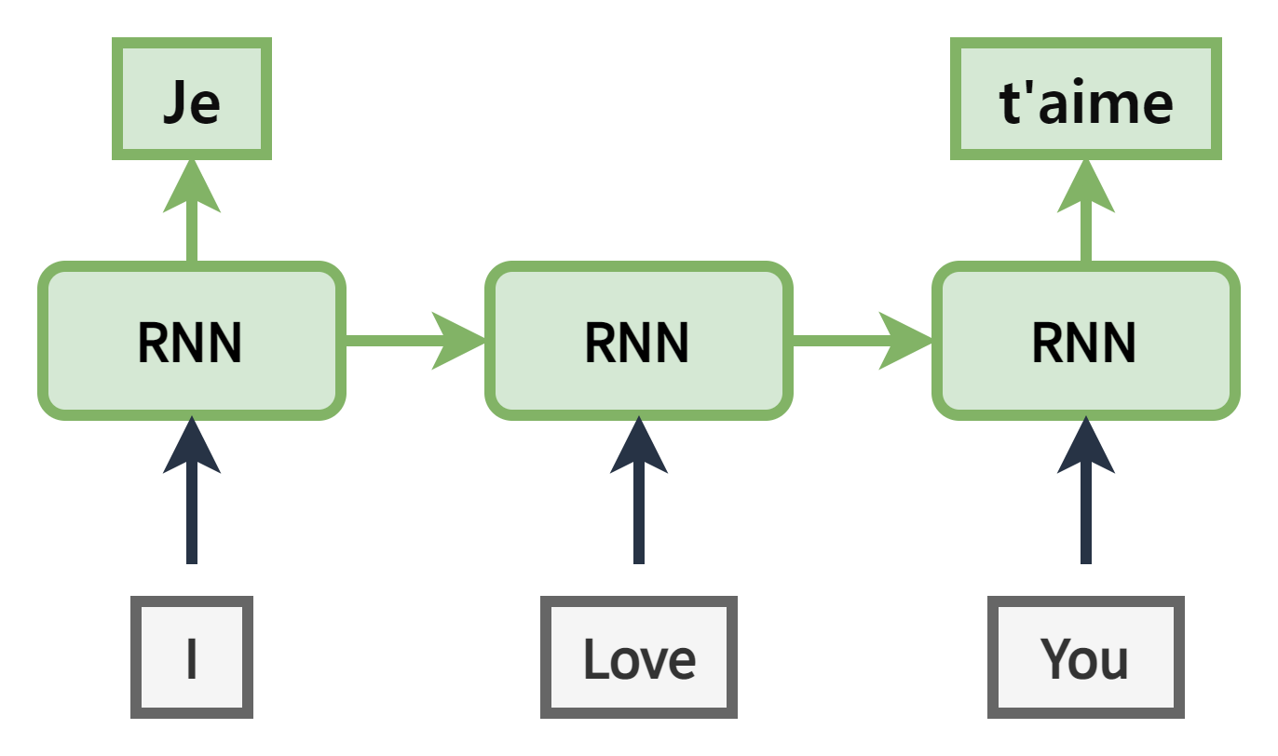
Alignment in NLP
Alignment between input sequence and output sequence
Ex) I Love You → Chinese and French
Single module translation model → One to one matching
https://dos-tacos.github.io/concept/alignment-in-rnn/

Slide 13
Alignment in NLP
Alignment between input sequence and output sequence
Ex) I Love You → Chinese and French
Single module translation model → One to one matching
Alignment models can solve the problem
I | Love | You
我 | 爱 | 你
Je |  | t'aime
https://dos-tacos.github.io/concept/alignment-in-rnn/

Slide 14
Alignment in NLP
Alignment between input sequence and output sequence
Ex) I Love You → Chinese and French
Single module translation model → One to one matching
Alignment models can solve the problem
I | Love | You
我 | 爱 | 你
Je |  | t'aime
https://dos-tacos.github.io/concept/alignment-in-rnn/

Slide 15
Translation Example
English to Korean
Ex) When is your birthday? (4 words) → 당신의 생일은 언제입니까? (3 words)
Traditional alignment methods (dynamic programming) can’t solve all the translation problems (SMT, NMT)
→ Sequence to Sequence model !
When | is | your | birthday
언제입니까 |  | 당신의 | 생일은

Slide 16
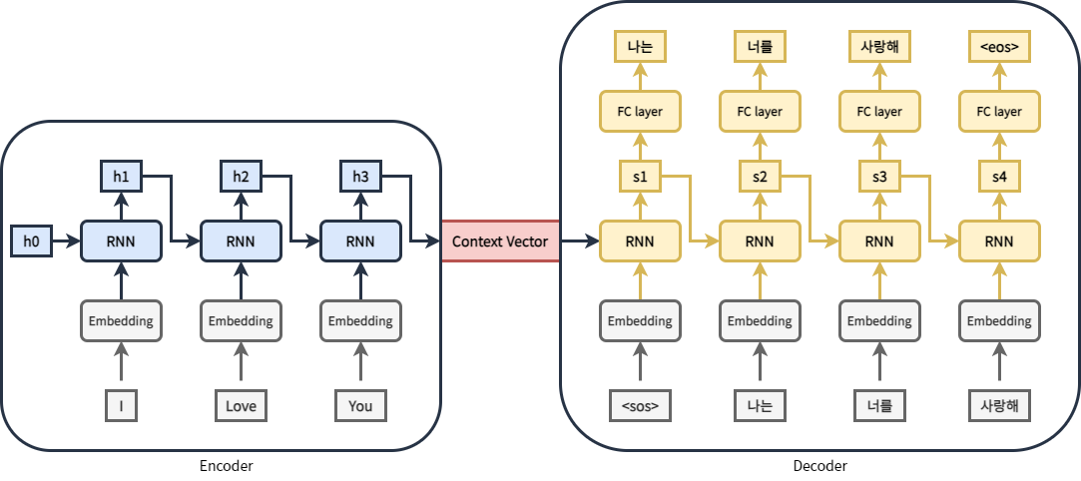
Encoder – Decoder (seq2seq)
RNN based Encoder – Decoder model
= Sequence-to-sequence = seq2seq
Context vector is fixed length
Compress information into fixed length
Bad performance
Sequential execution
Slower training

Slide 17
Encoder – Decoder (seq2seq)
RNN based Encoder – Decoder model
= Sequence-to-sequence = seq2seq
State-of-the-art model in language translation until Transformer
Context vector is fixed length
Compress information into fixed length → attention
Loss in long distance information
Sequential execution → transformer
Slower training

Slide 18
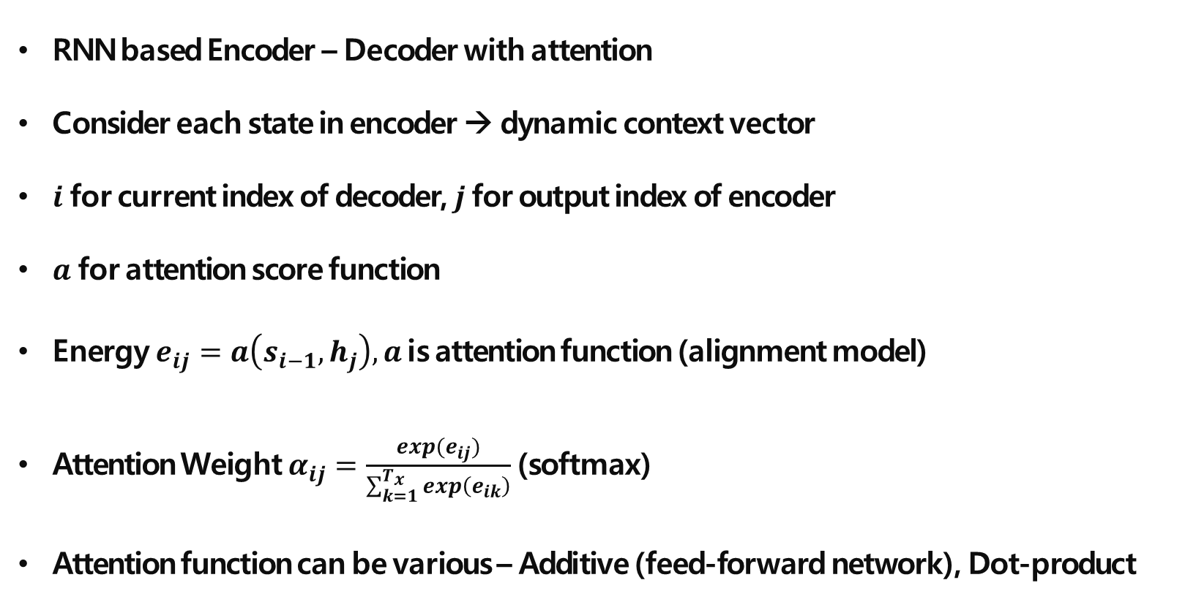
Encoder – Decoder with attention
RNN based Encoder – Decoder with attention
Consider each state in encoder → dynamic context vector
$i$ for current index of decoder, $j$ for output index of encoder
$a$ for attention score function
Energy $e_{ij}=a\left(s_{i−1}, h_{j}\right), a$ is attention function (alignment model)
Attention Weight $α_{ij}=\frac{exp(e_{ij})}{\sum_{k=1}^{T_{x}}{exp\left(e_{ik}\right)}}$ (softmax)
Attention function can be various – Additive (feed-forward network), Dot-product
Neural Machine Translation by Jointly Learning to Align and Translate." Dzmitry Bahdanau, Kyunghyun Cho, Yoshua Bengio (2015)

Slide 19
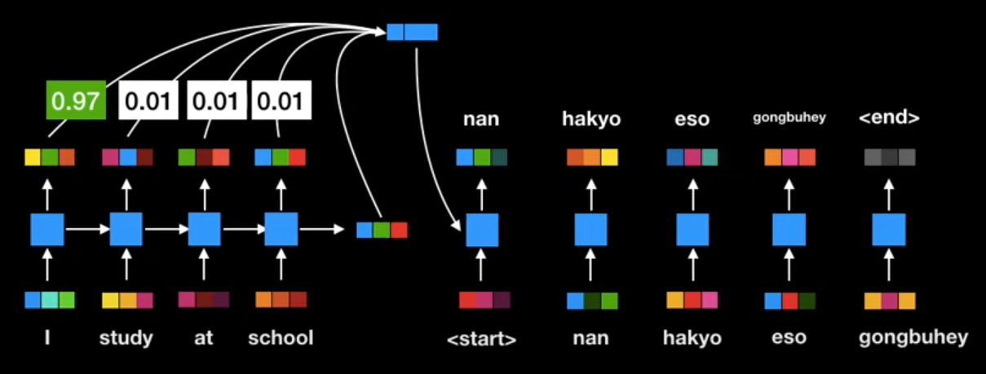
Encoder – Decoder with attention
RNN based Encoder – Decoder with attention
Consider each state in encoder → dynamic context vector
$i$ for current index of decoder, $j$ for output index of encoder
$a$ for attention score function
Energy $e_{ij}=a\left(s_{i−1}, h_{j}\right), a$ is attention function (alignment model)
Attention Weight $α_{ij}=\frac{exp(e_{ij})}{\sum_{k=1}^{T_{x}}{exp\left(e_{ik}\right)}}$ (softmax)
Attention function can be various – Additive (feed-forward network), Dot-product
https://www.youtube.com/watch?v=mxGCEWOxfe8&ab_channel=MinsukHeo%ED%97%88%EB%AF%BC%EC%84%9D

Slide 20
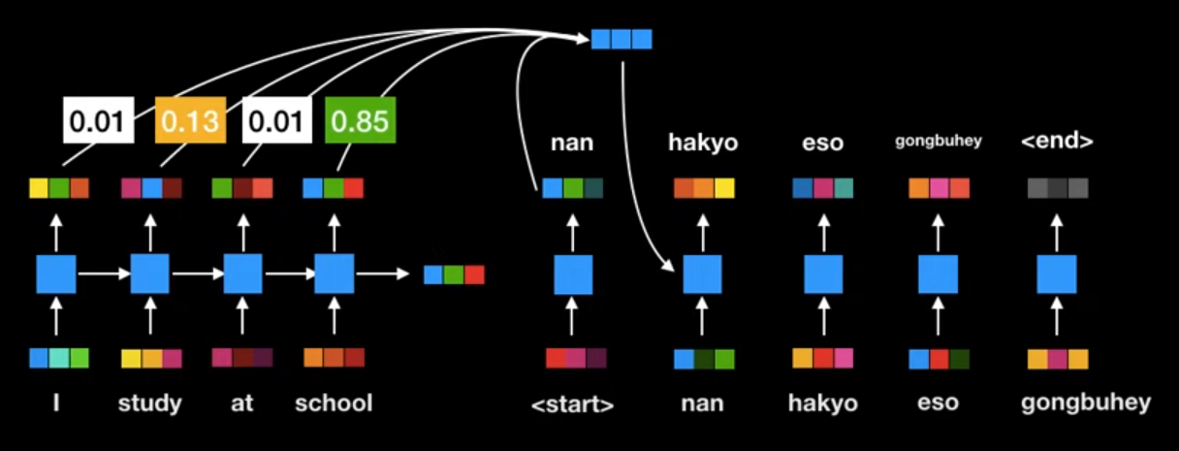
Encoder – Decoder with attention
RNN based Encoder – Decoder with attention
Consider each state in encoder → dynamic context vector
$i$ for current index of decoder, $j$ for output index of encoder
$a$ for attention score function
Energy $e_{ij}=a\left(s_{i−1}, h_{j}\right), a$ is attention function (alignment model)
Attention Weight $α_{ij}=\frac{exp(e_{ij})}{\sum_{k=1}^{T_{x}}{exp\left(e_{ik}\right)}}$ (softmax)
Attention function can be various – Additive (feed-forward network), Dot-product
https://www.youtube.com/watch?v=mxGCEWOxfe8&ab_channel=MinsukHeo%ED%97%88%EB%AF%BC%EC%84%9D

Slide 21
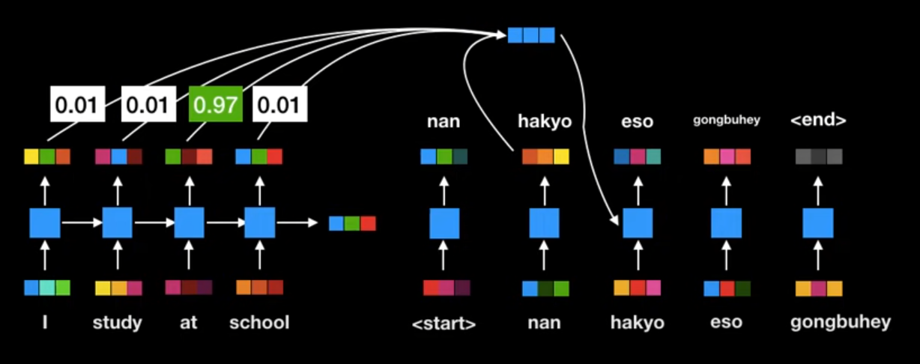
Encoder – Decoder with attention
RNN based Encoder – Decoder with attention
Consider each state in encoder → dynamic context vector
$i$ for current index of decoder, $j$ for output index of encoder
$a$ for attention score function
Energy $e_{ij}=a\left(s_{i−1}, h_{j}\right), a$ is attention function (alignment model)
Attention Weight $α_{ij}=\frac{exp(e_{ij})}{\sum_{k=1}^{T_{x}}{exp\left(e_{ik}\right)}}$ (softmax)
Attention function can be various – Additive (feed-forward network), Dot-product
https://www.youtube.com/watch?v=mxGCEWOxfe8&ab_channel=MinsukHeo%ED%97%88%EB%AF%BC%EC%84%9D

Slide 22
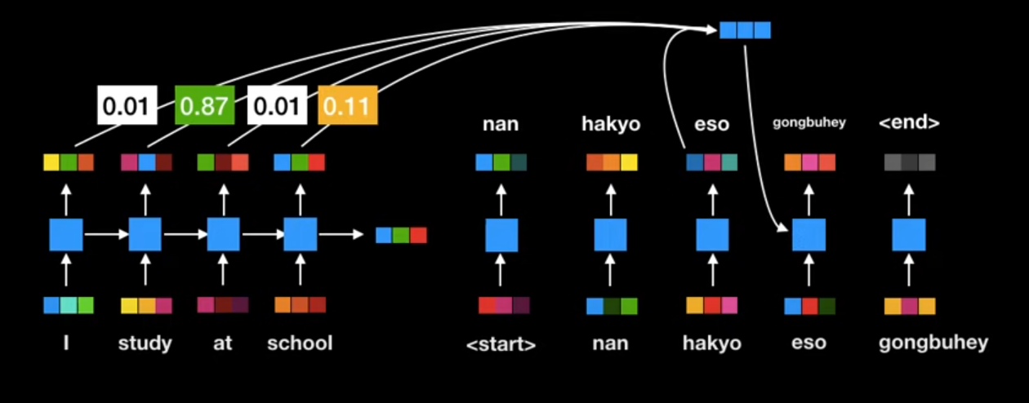
Encoder – Decoder with attention
RNN based Encoder – Decoder with attention
Consider each state in encoder → dynamic context vector
$i$ for current index of decoder, $j$ for output index of encoder
$a$ for attention score function
Energy $e_{ij}=a\left(s_{i−1}, h_{j}\right), a$ is attention function (alignment model)
Attention Weight $α_{ij}=\frac{exp(e_{ij})}{\sum_{k=1}^{T_{x}}{exp\left(e_{ik}\right)}}$ (softmax)
Attention function can be various – Additive (feed-forward network), Dot-product
https://www.youtube.com/watch?v=mxGCEWOxfe8&ab_channel=MinsukHeo%ED%97%88%EB%AF%BC%EC%84%9D

Slide 23
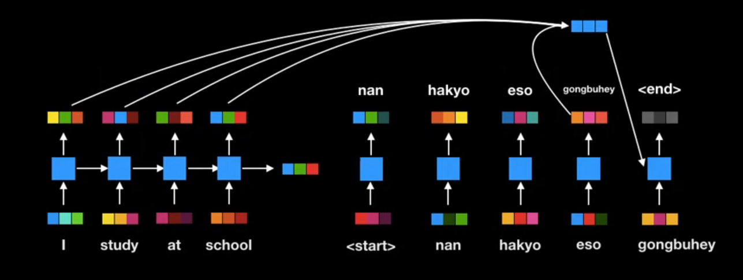
Encoder – Decoder with attention
RNN based Encoder – Decoder with attention
Consider each state in encoder → dynamic context vector
$i$ for current index of decoder, $j$ for output index of encoder
$a$ for attention score function
Energy $e_{ij}=a\left(s_{i−1}, h_{j}\right), a$ is attention function (alignment model)
Attention Weight $α_{ij}=\frac{exp(e_{ij})}{\sum_{k=1}^{T_{x}}{exp\left(e_{ik}\right)}}$ (softmax)
Attention function can be various – Additive (feed-forward network), Dot-product
https://www.youtube.com/watch?v=mxGCEWOxfe8&ab_channel=MinsukHeo%ED%97%88%EB%AF%BC%EC%84%9D

Slide 24
Encoder – Decoder with attention
RNN based Encoder – Decoder with attention
Better performance than seq2seq
Still slow training
https://www.youtube.com/watch?v=mxGCEWOxfe8&ab_channel=MinsukHeo%ED%97%88%EB%AF%BC%EC%84%9D

Slide 25
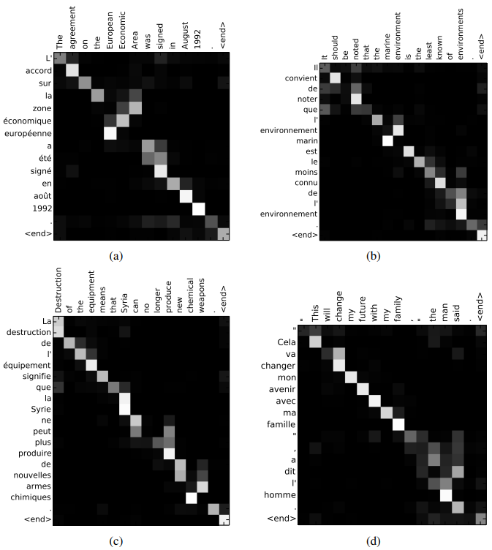
Encoder – Decoder with attention
RNN based Encoder – Decoder with attention
Better performance than seq2seq
Still slow training
Can find relation between tokens
Neural Machine Translation by Jointly Learning to Align and Translate." Dzmitry Bahdanau, Kyunghyun Cho, Yoshua Bengio (2015)

Slide 26
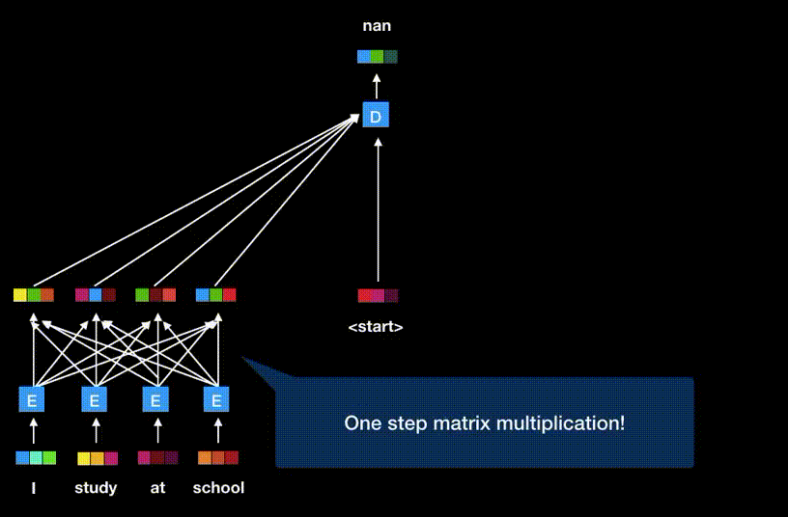
Transformer
Remove RNN
Attention is all you need!
How?
https://www.youtube.com/watch?v=mxGCEWOxfe8&ab_channel=MinsukHeo%ED%97%88%EB%AF%BC%EC%84%9D

Slide 27
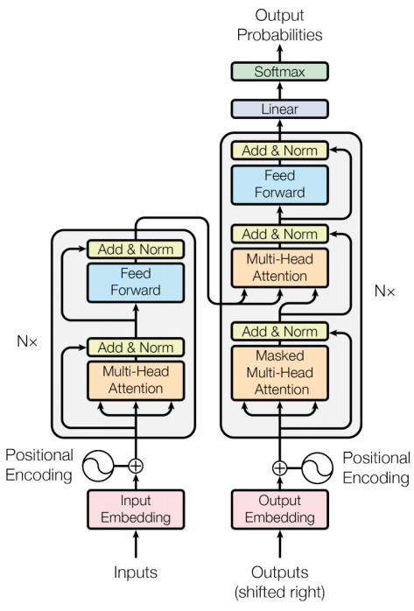
Transformer
Remove RNN
Attention is all you need!
How?
https://www.youtube.com/watch?v=mxGCEWOxfe8&ab_channel=MinsukHeo%ED%97%88%EB%AF%BC%EC%84%9D

Slide 28
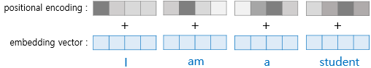
Positional Encoding
Encode position as a vector with same size of embedding vector
Add position vector to embedding vector

Slide 29
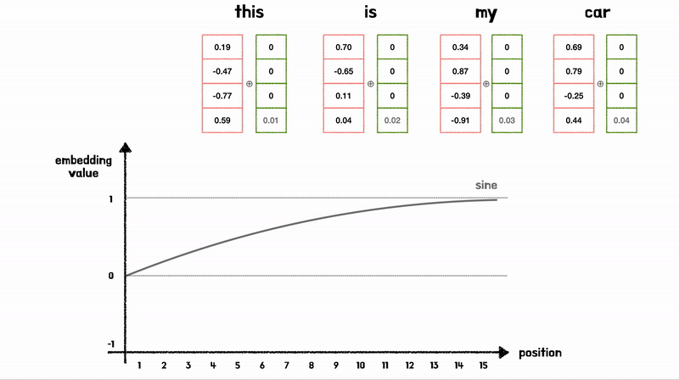
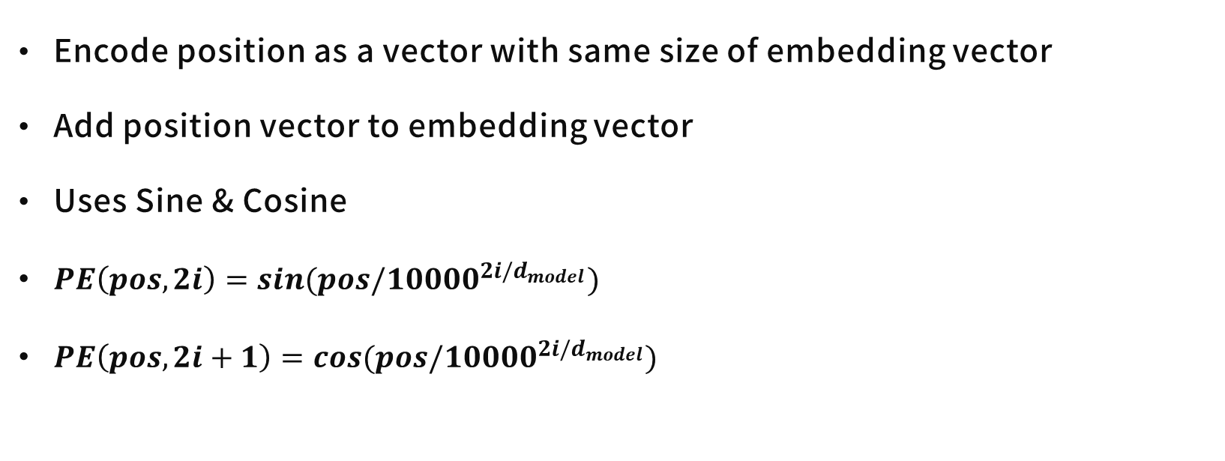
Positional Encoding
Encode position as a vector with same size of embedding vector
Add position vector to embedding vector
Uses Sine & Cosine
$PE\left(pos, 2i\right)=sin(pos/10000^{2i/d_{model}})$
$PE\left(pos, 2i+1\right)=cos(pos/10000^{2i/d_{model}})$
https://wikidocs.net/31379, https://www.blossominkyung.com/deeplearning/transfomer-positional-encoding

Slide 30
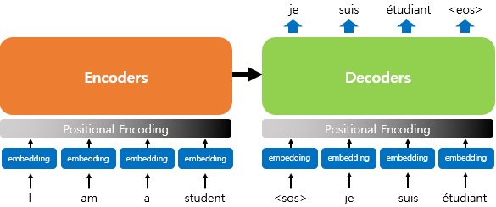
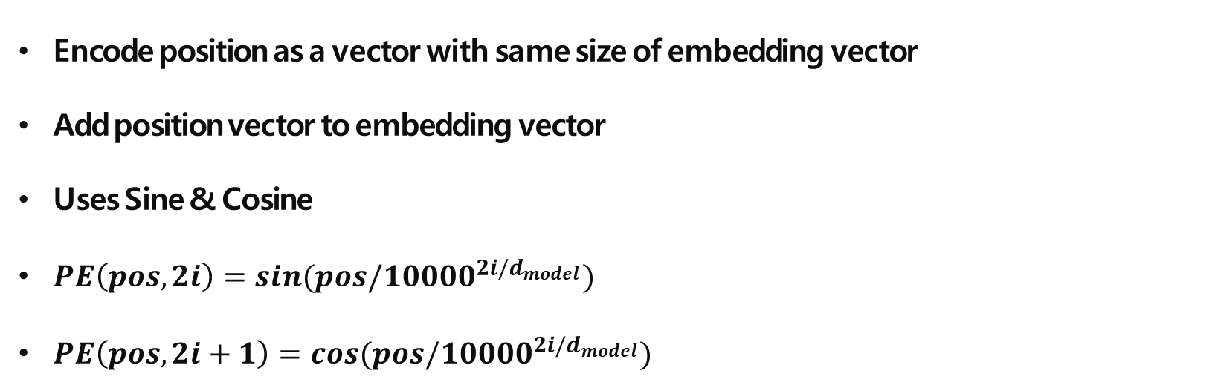
Positional Encoding
Encode position as a vector with same size of embedding vector
Add position vector to embedding vector
Uses Sine & Cosine
$PE\left(pos, 2i\right)=sin(pos/10000^{2i/d_{model}})$
$PE\left(pos, 2i+1\right)=cos(pos/10000^{2i/d_{model}})$
https://wikidocs.net/31379

Slide 31
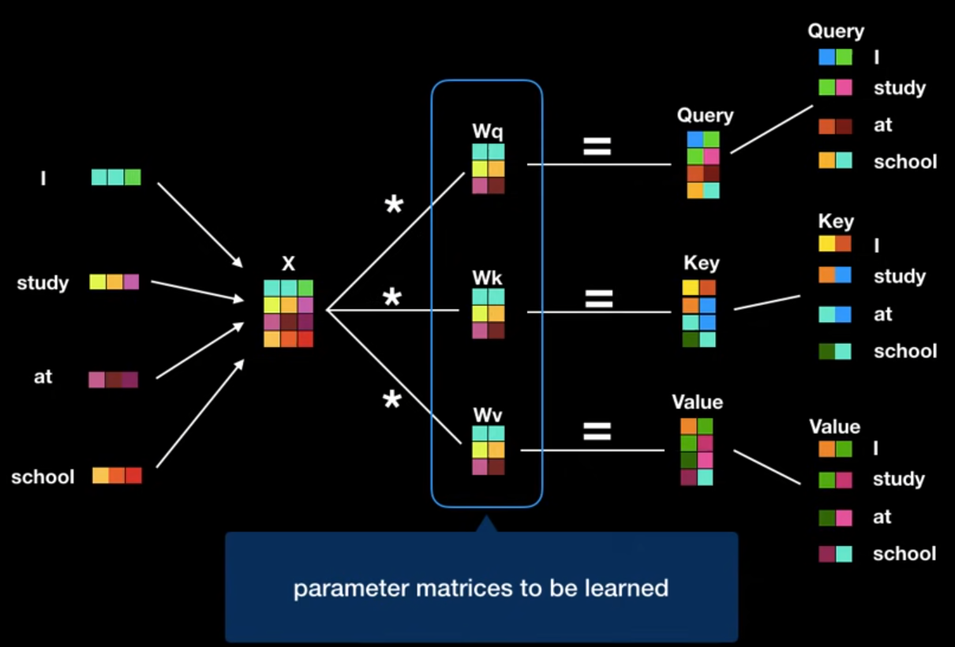
Self Attention
Query, Key, Value
Find Value of Query
Regarding to Keys
Key = words in sentence
Query = word to find value
https://www.youtube.com/watch?v=mxGCEWOxfe8&ab_channel=MinsukHeo%ED%97%88%EB%AF%BC%EC%84%9D

Slide 32
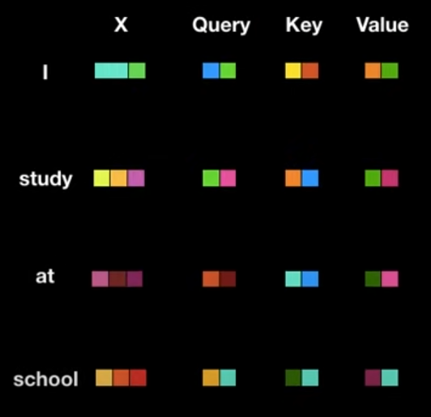
Self Attention
Query, Key, Value
Find Value of Query
Regarding to Keys
Key = words in sentence
Query = word to find value
https://www.youtube.com/watch?v=mxGCEWOxfe8&ab_channel=MinsukHeo%ED%97%88%EB%AF%BC%EC%84%9D

Slide 33
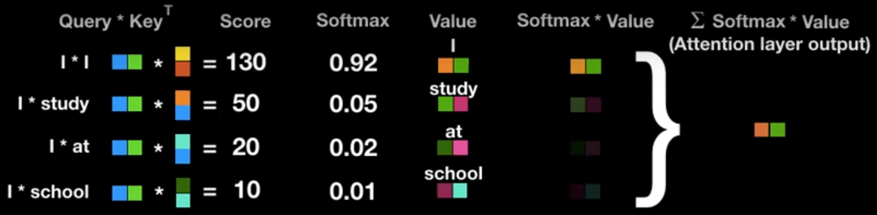
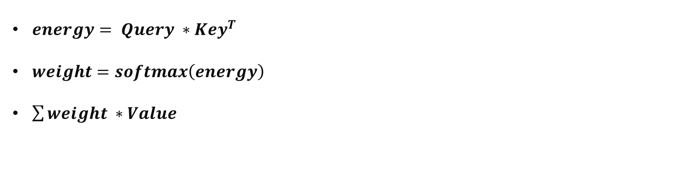
Self Attention
$energy= Query ∗Key^{T}$
$weight=softmax\left(energy\right)$
$\sum{weight ∗Value }$
https://www.youtube.com/watch?v=mxGCEWOxfe8&ab_channel=MinsukHeo%ED%97%88%EB%AF%BC%EC%84%9D

Slide 34
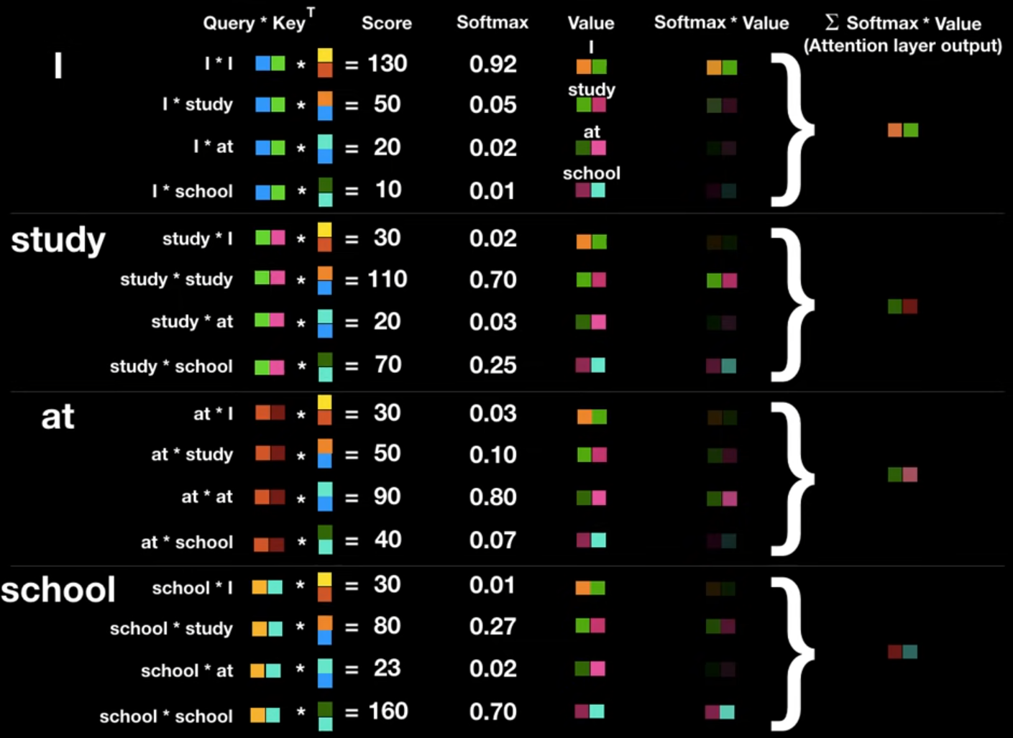
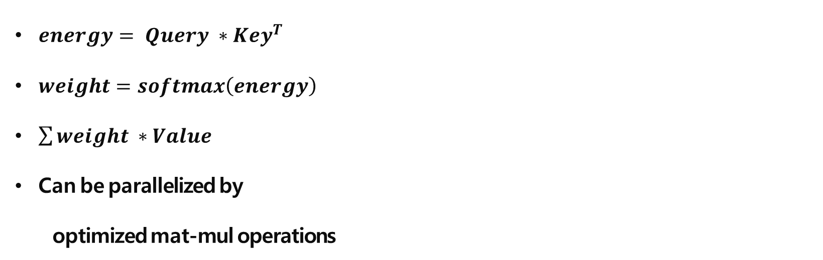
Self Attention
$energy= Query ∗Key^{T}$
$weight=softmax\left(energy\right)$
$\sum{weight ∗Value }$
Can be parallelized by
optimized mat-mul operations
https://www.youtube.com/watch?v=mxGCEWOxfe8&ab_channel=MinsukHeo%ED%97%88%EB%AF%BC%EC%84%9D

Slide 35
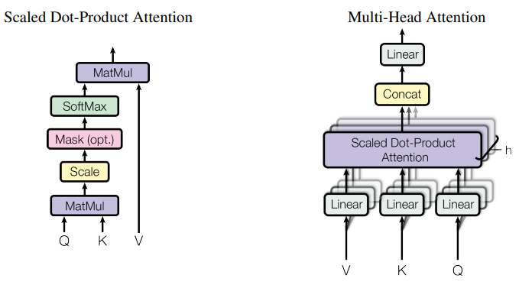
Self Attention
$energy= Query ∗Key^{T}$
$weight=softmax\left(energy\right)$
$\sum{weight ∗Value }$
Can be parallelized by
optimized mat-mul operations
https://www.youtube.com/watch?v=mxGCEWOxfe8&ab_channel=MinsukHeo%ED%97%88%EB%AF%BC%EC%84%9D

Slide 36
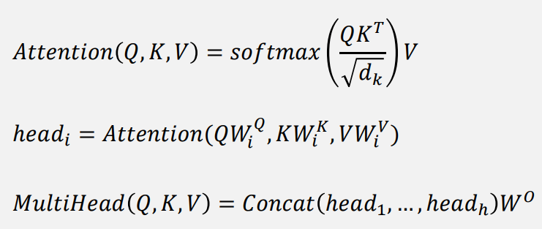
Scale Dot-product Attention
Multi-Head Attention

Slide 37
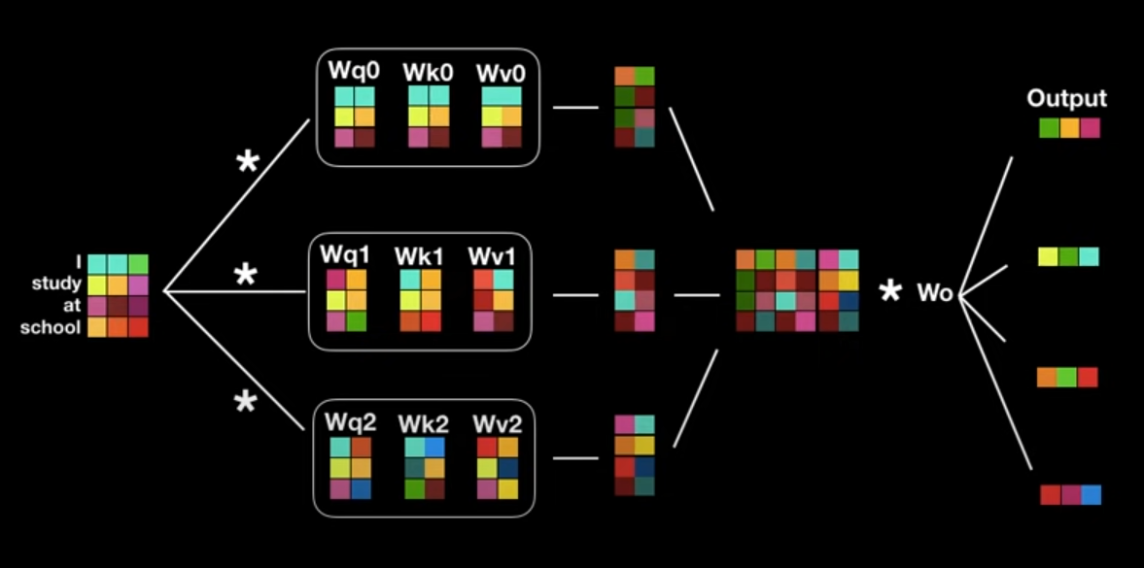
Multi-Head Attention
Multi-Head Attention

Slide 38
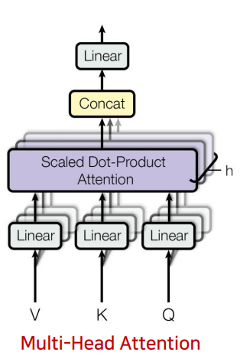
Multi-Head Attention
Multi-Head Attention

Slide 39
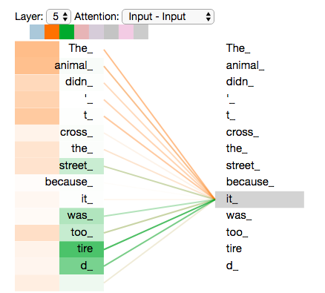
Multi-Head Attention
Multi-Head Attention

Slide 40
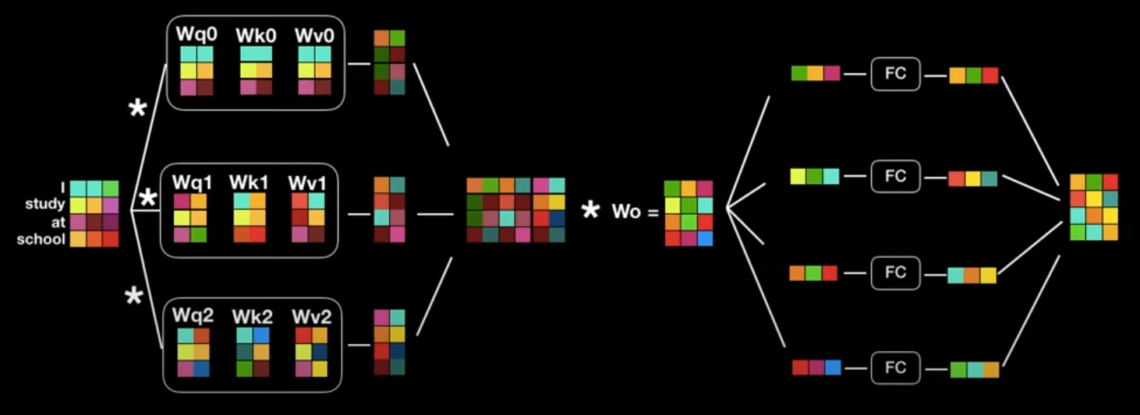
Structure
Encoder

Slide 41
Structure
Encoder
Residual Connection
Six layers

Slide 42
Structure
Decoder has two layers the same with Encoder, and 3rd layer
Auto-regressive to generate output sequence
3rd layer uses Query from Encoder, Key and Value from Decoder
Masking to prevent attending to subsequent positions

Slide 43
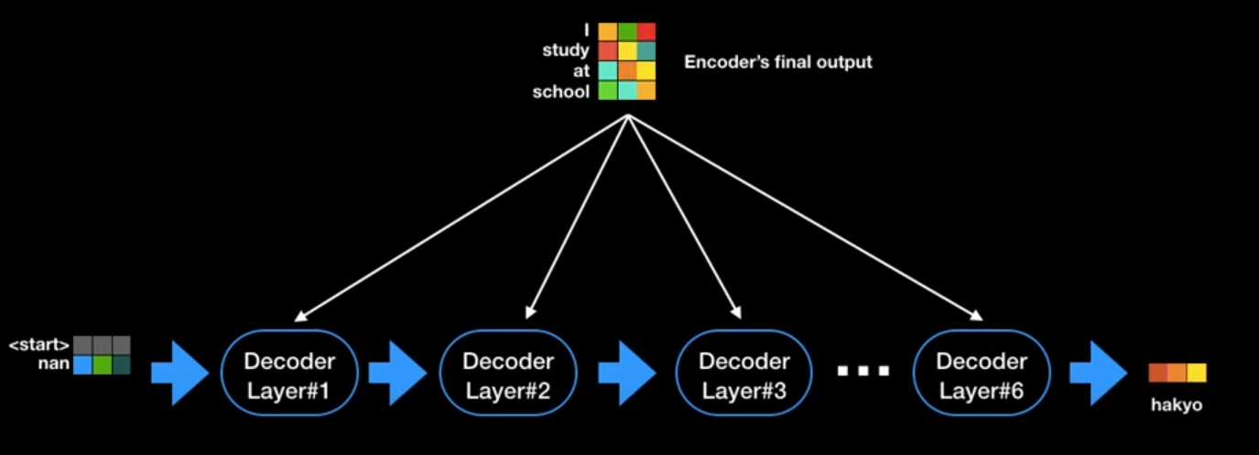
Structure
Decoder has two layers the same with Encoder, and 3rd layer
Auto-regressive to generate output sequence
3rd layer uses Query from Encoder, Key and Value from Decoder
Masking to prevent attending to subsequent positions

Slide 44
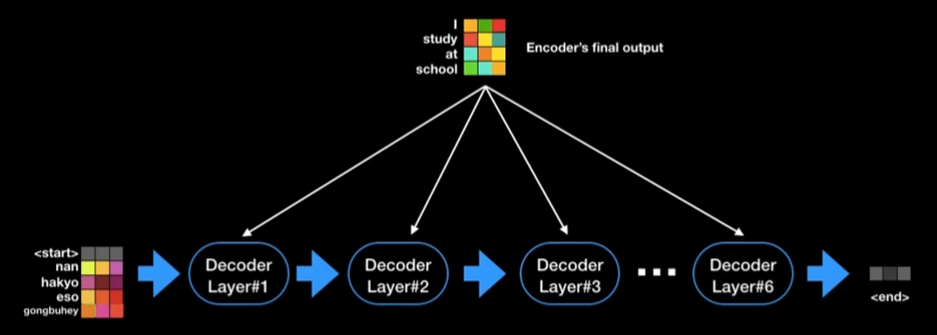
Structure
Decoder has two layers the same with Encoder, and 3rd layer
Auto-regressive to generate output sequence
3rd layer uses Query from Encoder, Key and Value from Decoder
Masking to prevent attending to subsequent positions

Slide 45
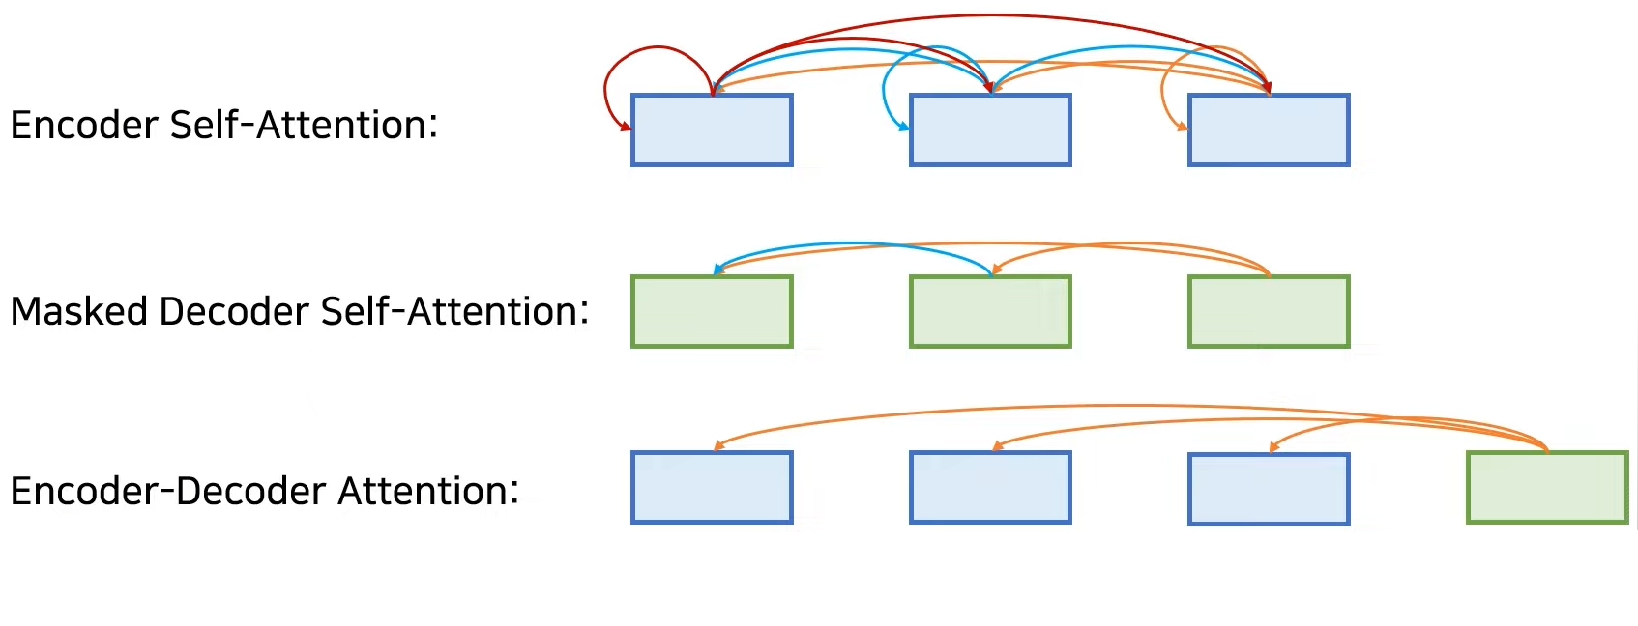
Structure
Decoder has two layers the same with Encoder, and 3rd layer
Auto-regressive to generate output sequence
3rd layer uses Query from Encoder, Key and Value from Decoder
Masking to prevent attending to subsequent positions

Slide 46
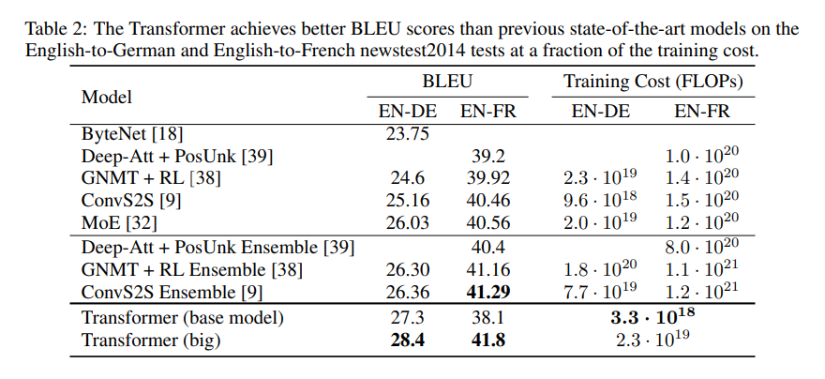
Result

Slide 47
Conclusion
First sequence transduction model based entirely on attention
SOTA model with best performance and less cost
Self-Attention

Slide 48
Thank
You
감사합니다.

